Slide 1
PDF READER
USING PYTHON

Slide 2
IMPORTANT OF PDF READER
The most intriguing benefit of using the PDF format is the user can rest assured that everyone with whom the file is shared will easily see its content without any distortion.
Even the PDF creator is easy to use and shouldn’t take you more than a few minutes to convert different files.
The PDF format allow you to integrate various types of content .

Slide 3
CODE
from tkinter import * import PyPDF2 from tkinter import filedialog import pyttsx3 root =Tk() root.title('Praresh-PDF Reader!') root.geometry("500x500") # for textbox my_text= Text(root,height=40,width=70) my_text.pack(pady=10) #for clear the textbox def clear_text_box(): my_text.delete(1.0,END) # for open def open_pdf(): open_file = filedialog.askopenfilename( title="Open PDF file", filetypes=( ("PDF Files", "*.pdf"), ("All Files","*.*"))) if open_file: # for open pdf file pdf_file = PyPDF2.PdfFileReader(open_file) # for Set the page page = pdf_file.getPage(0) # exract the text from text from th pdf file page_stuff = page.extractText() # add text to textbox my_text.insert(1.0,page_stuff)

Slide 4
def speak_pdf(): open_file = filedialog.askopenfilename( title="Open PDF file", filetypes=( ("PDF Files", "*.pdf"), ("All Files", "*.*"))) if open_file: # for open pdf file pdf_file = PyPDF2.PdfFileReader(open_file) # for Set the page page = pdf_file.getPage(0) # exract the text from text from th pdf file page_stuff = page.extractText() # add text to textbox my_text.insert(1.0, page_stuff) speak = pyttsx3.init() speak.say(page_stuff) speak.runAndWait() #for menu my_menu = Menu(root) root.config(menu=my_menu) file_menu= Menu(my_menu,tearoff=False) my_menu.add_cascade(label="file",menu=file_menu) file_menu.add_command(label="Open",command=open_pdf) file_menu.add_command(label="Clear",command=clear_text_box) file_menu.add_command(label="listen",command=speak_pdf) file_menu.add_separator() file_menu.add_command(label="Exit",command=root.quit) root.mainloop()

Slide 5
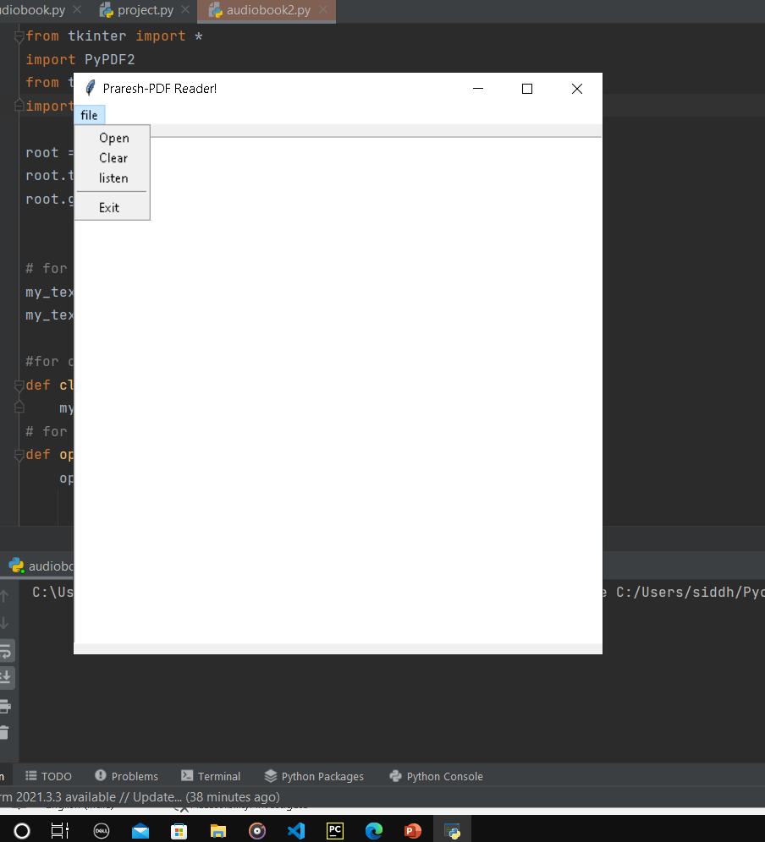
EXAMPLE OUTPUT

Slide 6
TKINTER
IT COMES WITH ALL THE MODULE DEFINED IN TKINTER
HOWEVER TO SAVE THE MAJOR TYPING EFFORTS WE IMPORT THE TKINTER LIBRARY WITH ACRONYM FURTHER THAT CAN BE USED TO CREATE A INSISTANCE OF WIDGETS
IT IS A GUI TOOLKIT

Slide 7
PyPDF2
IT IS A PURE –PYTHON LIBRARY
IT IS USED FOR PERFORMING MAJOR TASKS ON PDF FILES SUCH AS EXTRACTING THE DOCUMENTATION SPECIFIC INFORMATION MERING THE PDF FILES.
SPECIFIC THE PAGES OF A PDF FILES
ADDING THE PAGES OF A PDF FILES
ENCYPTING AND DECYPTING THE PDF FILES ETC.

Slide 8
Pyttsx3
Pyttsx3 is a text –to-speech conversion library in python
Unlike alternative libraries it works offline and compatible

Slide 9
PROJECT BY
SIDDHANT GAIKWAD(18UET012)
SANDESH KAMBLE (18UET020)
NARESH SHARMA(18UET057)
PRASAD SABANE(18UET053)

Slide 10
THANK YOU

